Slide 1

Sindh Engro Coal Mining Company Thar Block II Open Pit Lignite Mine Power Sourcing Economic Modeling
V2.0 | 16-04-24

Slide 2
Baseline Site, Load and Energy Data

Slide 3

Load Projection
The above load projection as well as hourly load data was combined to form hourly load projections over 12 years.

Slide 4
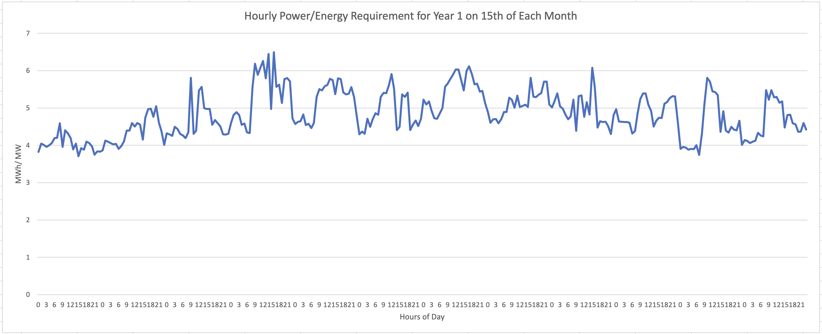
Hourly Energy Demand Projection
The first task of the model is to select sources that can meet the hourly energy demand.

Slide 5
Energy Demand

Slide 6
Key Assumptions

Slide 7
Assumptions
Exchange Rate: 1 USD = 290
Loss amount: PKR 34,000,000 per hour of critical load interruption
Loss duration: any load interruptions due to power failures are considered to be only one hour long. This is because most load interruptions will be caused by lack of stability and inadequate spinning reserve in the system
Existing generator sets capital cost: PKR 45,000,000 per MW.
Above CAPEX is used to determine depreciation (straight-line, 10-year life)
Source probable failures and downtimes are defined as per experience for each source type (see Source Details)

Slide 8
Assumptions
BESS units provide instantaneous backup to any kind of power deficit due to inadequate capacity of sources or sudden reduction of capacity.
Load shedding of non-critical load does not result in any financial loss.

Slide 9
Inflation Assumptions
Model incorporates different inflation levels for each source.
Solar and BESS sources have 5% inflation rate reflecting decreasing $/W cost due to technology improvements.
Steam Turbine source also has 5% inflation rate, as fuel is locally available at a subsidized cost.
Furnace oil and diesel fueled generator sources have a higher 7.5% inflation due to import dependence.

Slide 10
Details of Power Sources

Slide 11
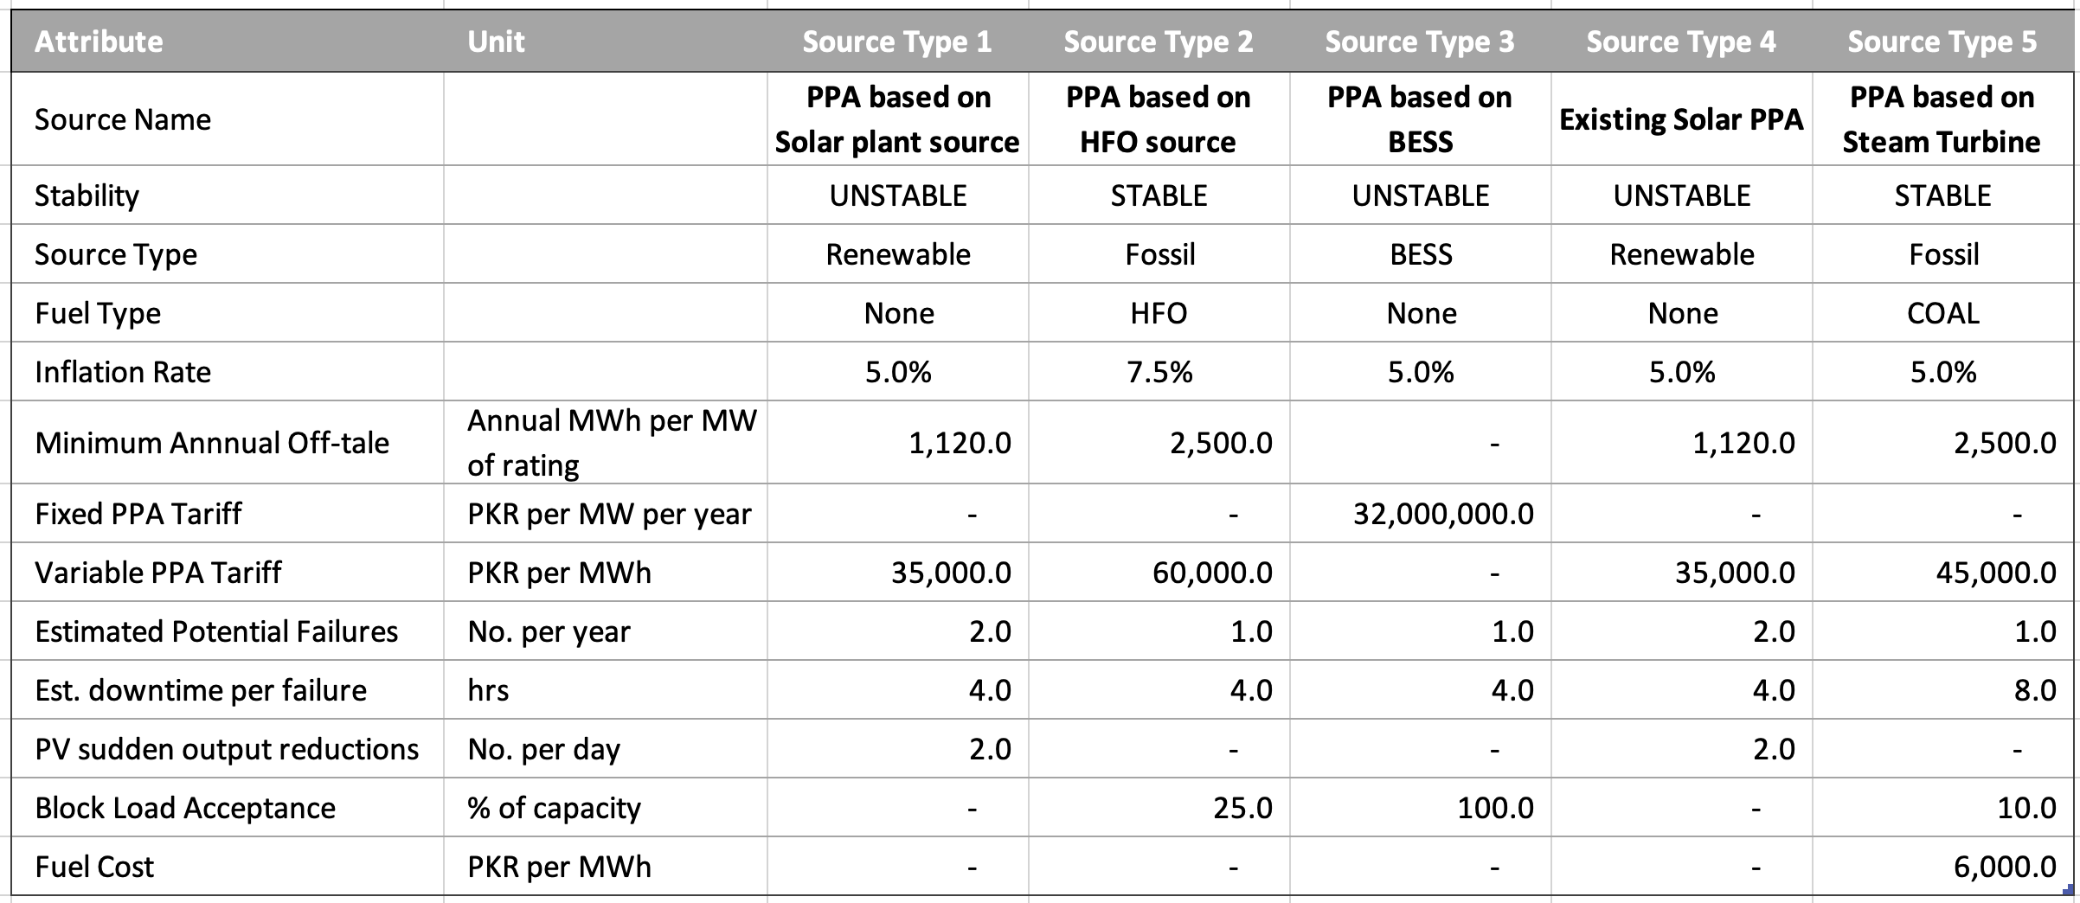
Source Details (PPA Sources)

Slide 12
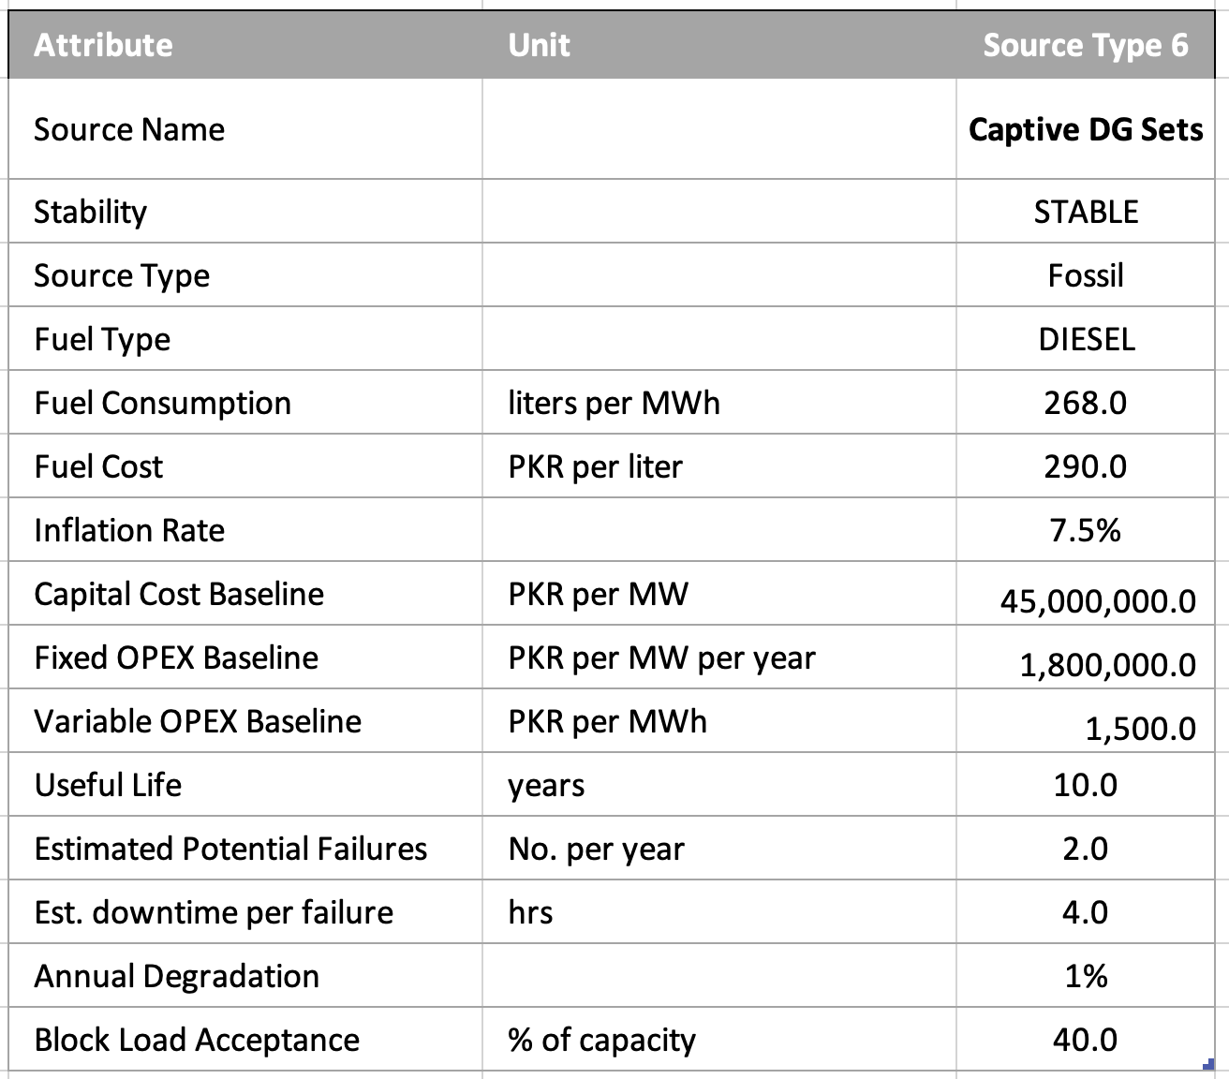
Source Details (Captive Source)

Slide 13
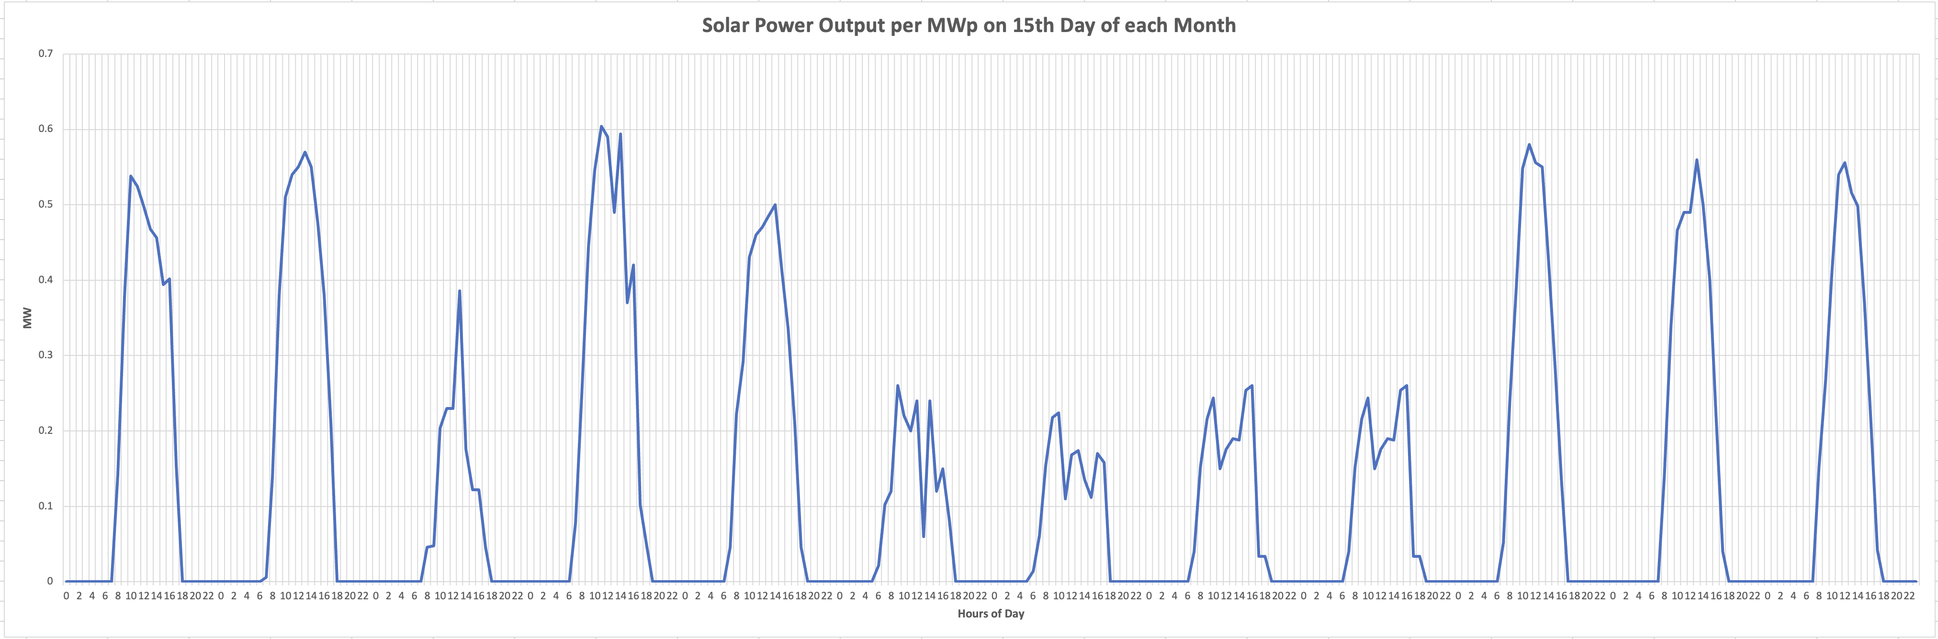
PV Generation Trend

Slide 14
Modeling Algorithm, Evaluation and Results

Slide 15
Model Algorithm/ Approach
Consider hourly power demand
Meet Remaining demand with least number of highest priority sources
Utilize Reserves and BESS, if needed to meet demand, otherwise preserve
Simulate probabilistic source failures
Check if operational sources/ BESS can meet sudden deficit within 4 seconds
If required, shed non-critical load,
Repeat for each hour in day, in month, in years (12)
Aggregate technical and commercial data
Input Load, Solar Profile and Source Configuration
Calculate Evaluation Metrics
Start
End
Operate Stable sources at min load req. for Spinning Reserve
Record data operating hourly data

Slide 16
Scenario Evaluation Metrics
1. Energy Fulfilment Ratio (%):
Calculated for each year and as a single metric
Number of hours in which power sources meet energy requirements without load shedding / total number of hours
Must be 99-100% for scenario to be viable
2. Critical Load Interruptions (No.):
Calculated for each year and as a single metric
Number of times critical load is interrupted due to source failures (and inadequate spinning reserve) despite non-critical load shedding
3. Load Shedding Events(No.):
Non-critical loads are shed if sources cannot meet critical load requirements. While this is not modeled to result in financial loss, it is a sustainability consideration

Slide 17


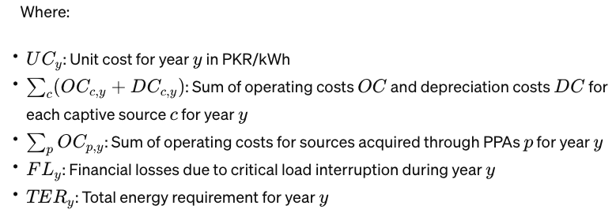
Scenario Evaluation Metrics (continued)
4. Average Unit Cost (AUC) in PKR/ kWh:

Slide 18
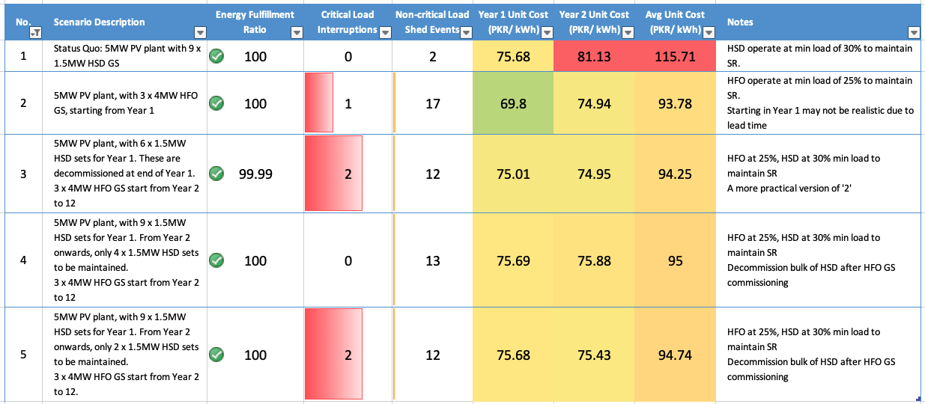
Modeling Outcomes

Slide 19
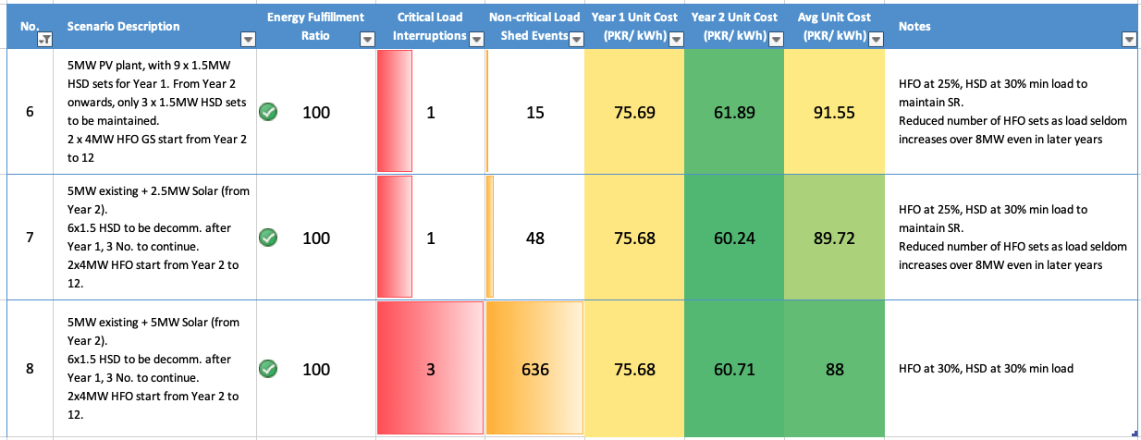
Modeling Outcomes (contd.)

Slide 20
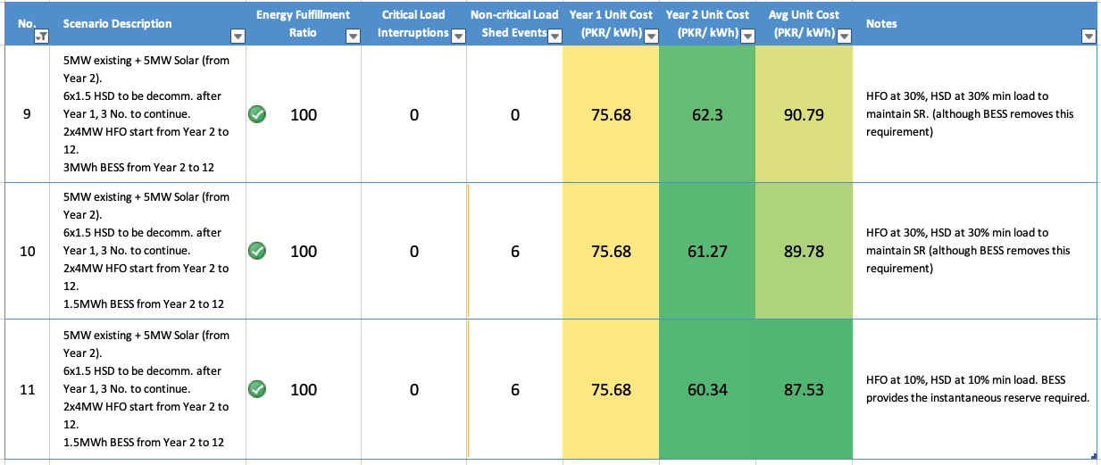
Modeling Outcomes (contd.)

Slide 21
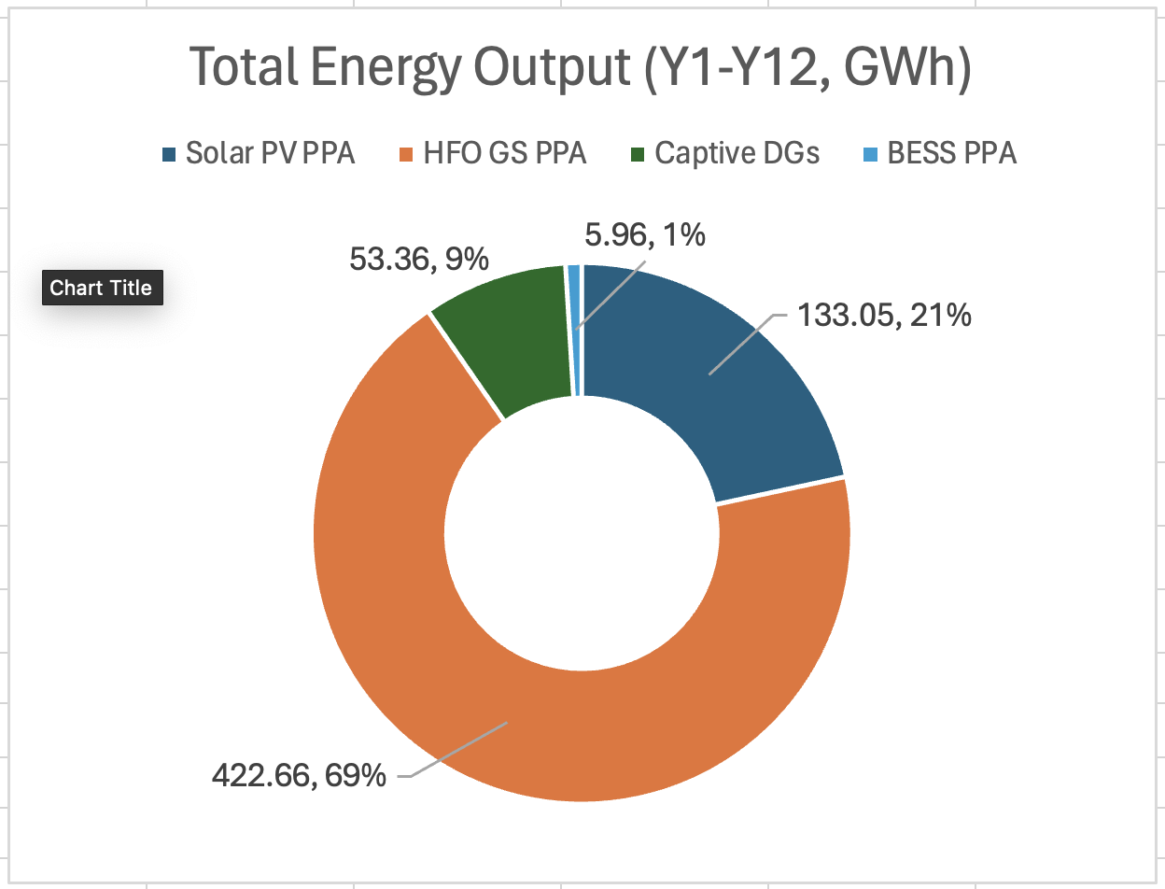
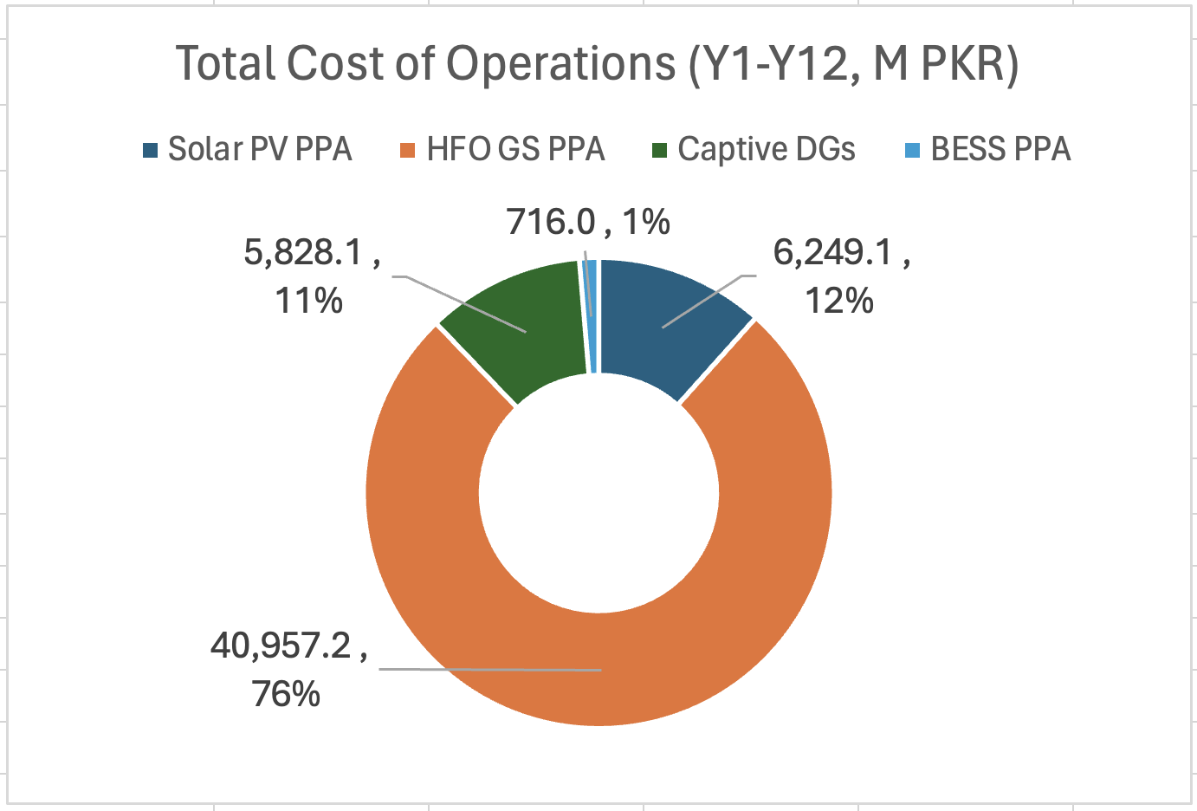
Scenario 11: Summary

Slide 22
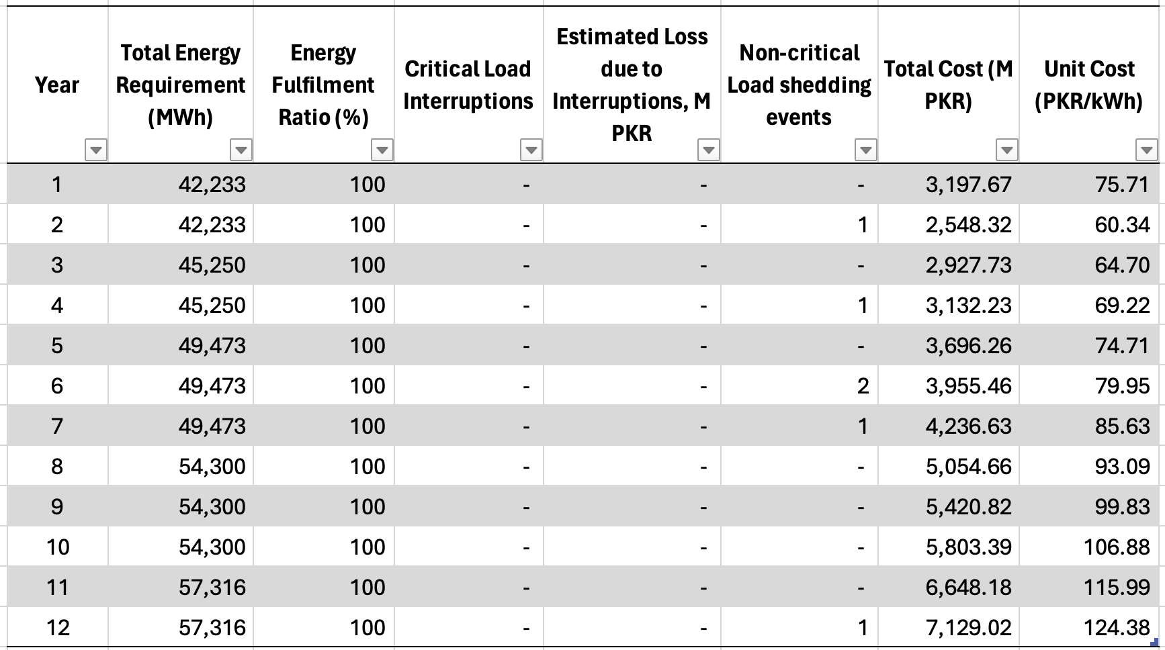
Scenario 11: Year-wise commercial breakdown
Additional 5MW Solar, BESS and HFO are provisioned from Year-2

Slide 23
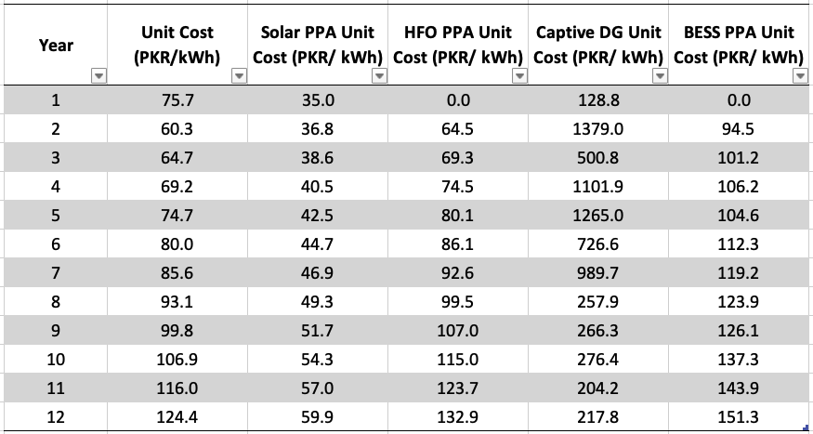
Scenario 11: Unit Costs by Source, by Year
High values in DG are due to low utilization as HFO primary source. Despite limited operation, fixed OPEX and depreciation is incurred on DGs after Year 1
Lower Spinning Reserve Values on HFO (because of BESS) increases utilization so that HFO remains above its minimum off-take value, which optimizes its unit cost.

Slide 24
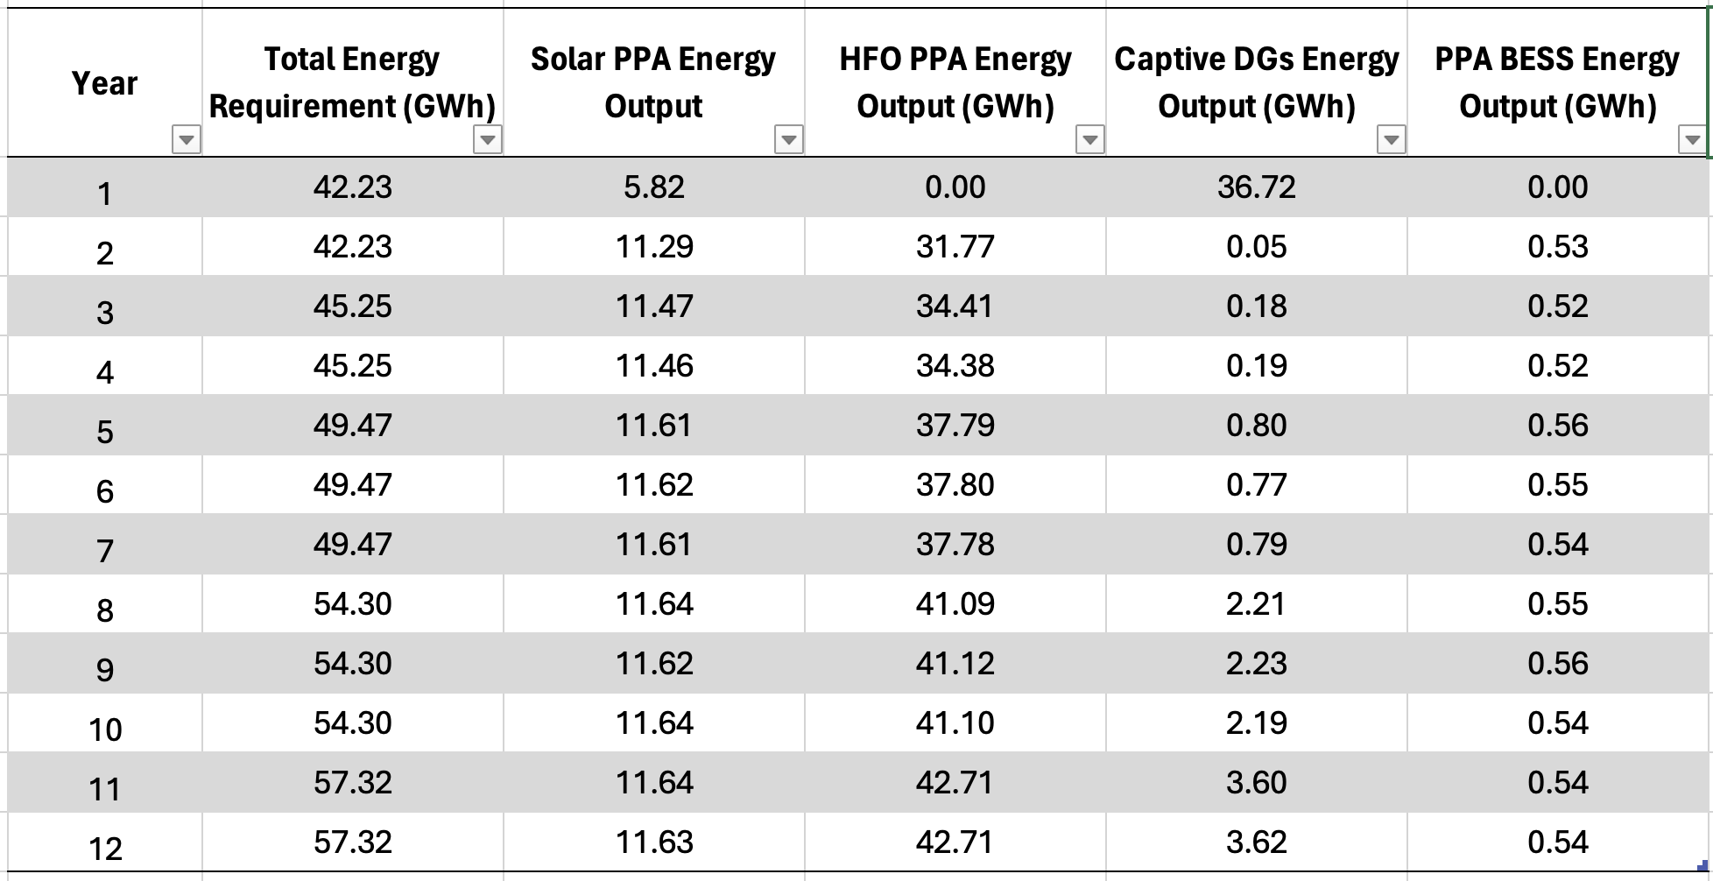
Scenario 11: Energy- by year, by source
Additional 5MW Solar, BESS and HFO are provisioned from Year-2
BESS provides stability, instantaneous recovery from sudden reductions in solar, which are assumed to take place twice each day.
DGs are used as backup and only contribute during peak load times when Solar is not available, or during outage of HFO generators. In later years, DG utilization increases.

Slide 25
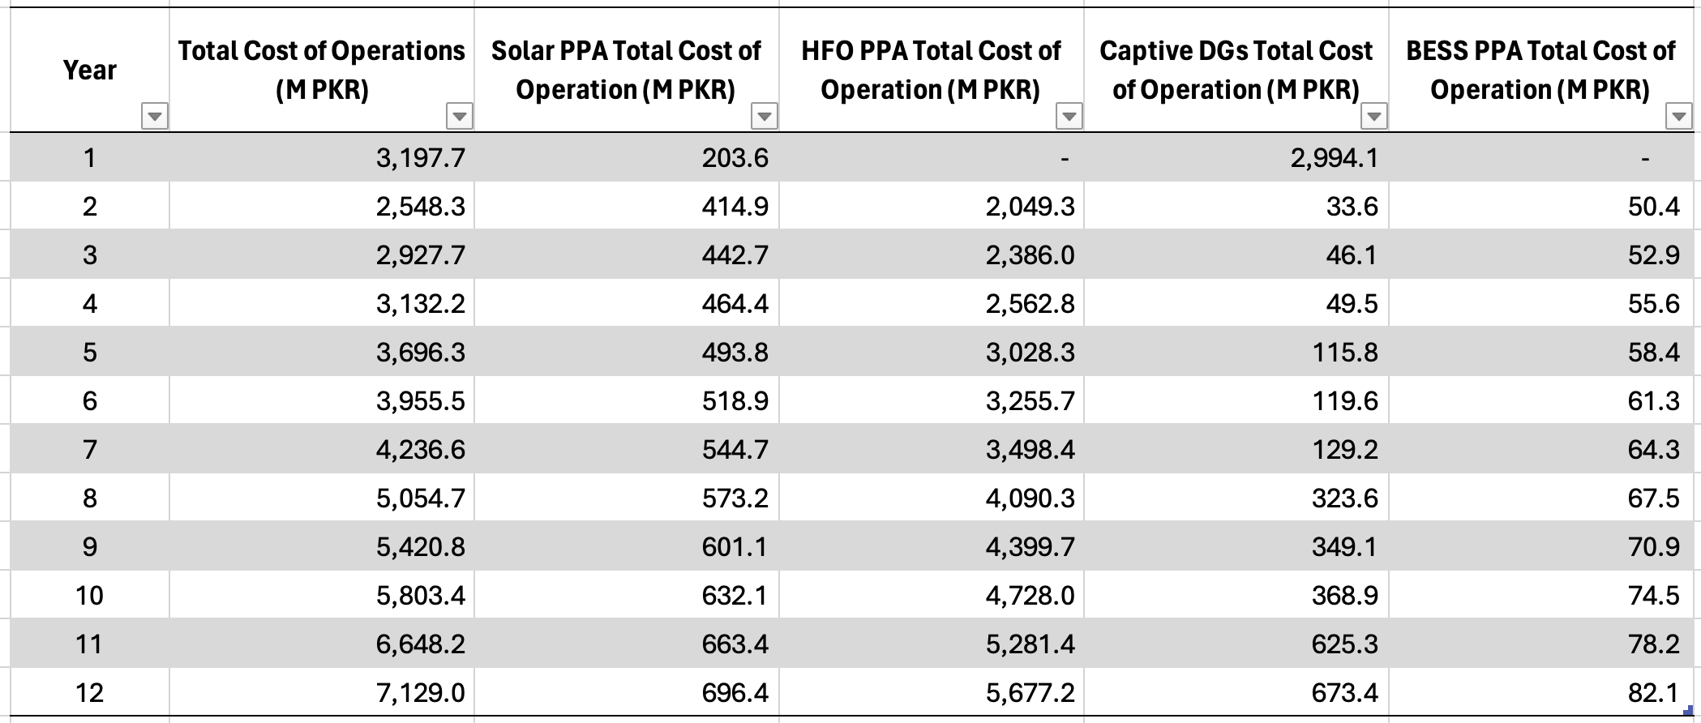
Scenario 11: Costs by Year, by Source

Slide 26
Discussion
Scenarios 7 and 8 show the advantage of increasing solar capacity. However, they also show the problems with doing so as it increases instability in the system, which cannot be catered for by HFO generators, despite maintaining high spinning reserve.
In Scenarios 7 and especially 8, HFO generators are unable to accept the block load presented due to sudden reductions in solar output. This is exasperated by solar expansion to 7.5 and 10MW. This leads to a high number of non-critical load shedding events. It is important to note that the model does not impose a financial penalty for load shedding of non-critical load.
We can see in Scenarios 9-11 that BESS reduces both critical load interruptions and non-critical load shedding to almost zero.

Slide 27
Discussion
The biggest advantage can be seen in Scenario 11, where Spinning Reserve in the HFO generators can be maintained at a very low level.
This allows full HFO capacity to be utilized for feeding load, thus further reducing DG operation and optimizing cost.
We have tried other combinations of solar and BESS. Increasing solar further does not yield substantial cost reduction as it reduces HFO to below minimum off-take values. Also, solar cannot be increased without a proportional increase in BESS (to counteract instability) which, beyond 1.5MWh, pushes the unit costs up.

Slide 28

Thank you!

